Slide 1
Segmentation and Registration of Brain Tumor
Computer Vision 2022 Fall
Yuliang Xiao
Yuanwu He
Xiao Fu

Slide 2
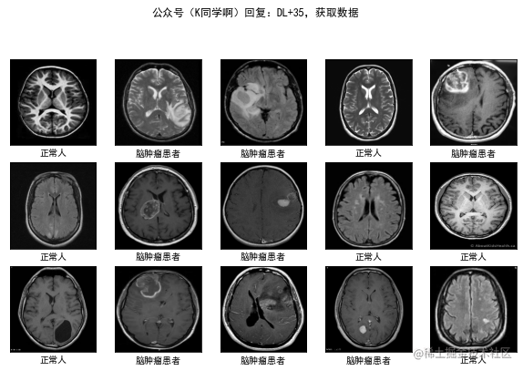
Introduction
Segmentation and Registration of Brain Tumor based on nnU-Net and Voxelmorph
Why we detect tumor by deep learning
Save time
Integrate into medical robots easily
Increase working efficiency
healthy tumor tumor healthy tumor
Approaches
1. nnU-Net
2. Voxelmorph
healthy tumor tumor healthy healthy
healthy tumor tumor tumor healthy

Slide 3
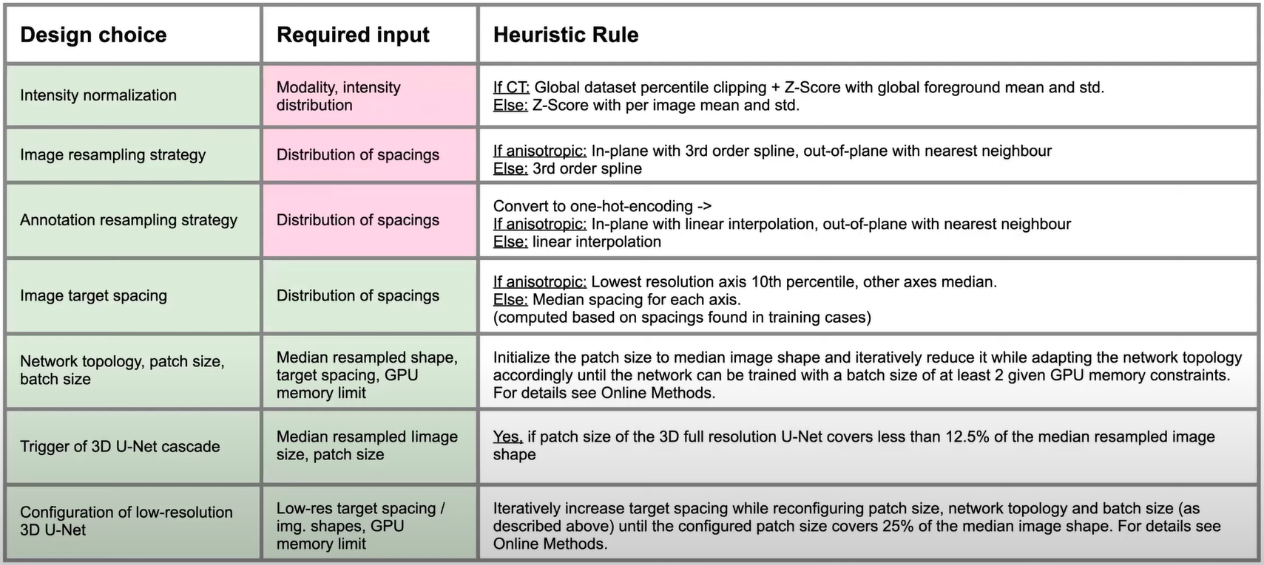
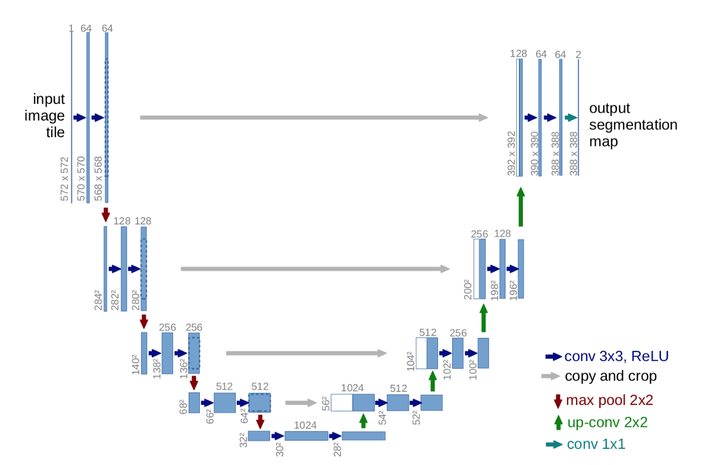
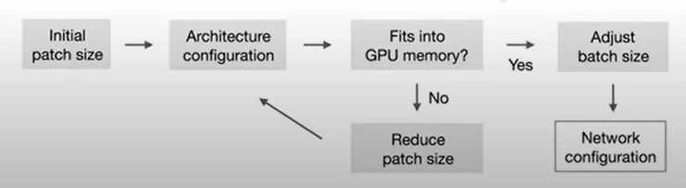
Introduction of nnU-Net
Segmentation and Registration of Brain Tumor based on nnU-Net and Voxelmorph
What is nnU-Net
A segmentation method based on U-Net architecture and generate a probability map to tell where the labels most likely locate
Why we use nnU-Net?
nnU-Net automatically configures itself for arbitrary biomedical datasets.
Don’t need expert knowledge
Heuristic Rule

Slide 4
Introduction of nnU-Net
Segmentation and Registration of Brain Tumor based on nnU-Net and Voxelmorph
What is nnU-Net
A segmentation method based on U-Net
Why we use nnU-Net?
nnU-Net automatically configures itself for arbitrary biomedical datasets.
Don’t need expert knowledge
Heuristic Rule

Slide 5
Introduction of nnU-Net
Segmentation and Registration of Brain Tumor based on nnU-Net and Voxelmorph
What is nnU-Net
A segmentation method based on U-Net
Why we use nnU-Net?
nnU-Net automatically configures itself for arbitrary biomedical datasets.
Don’t need expert knowledge

Slide 6
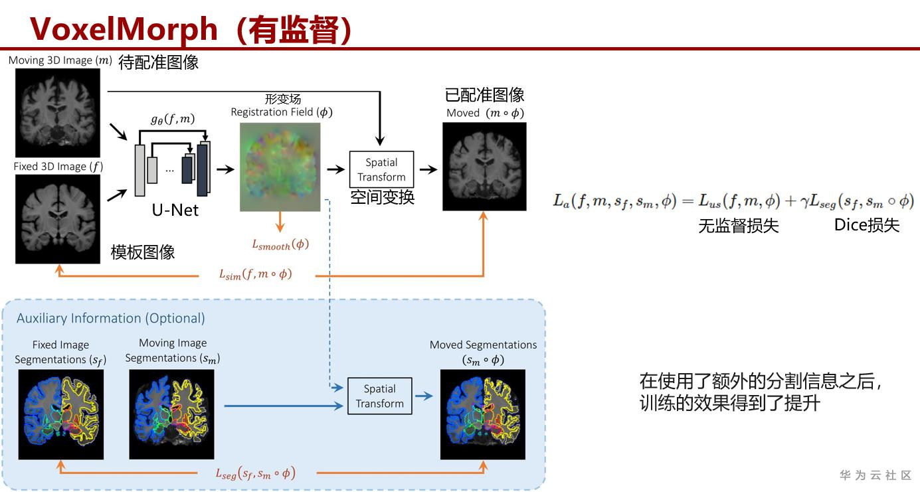

Introduction of VoxelMorph
Segmentation and Registration of Brain Tumor based on nnU-Net and Voxelmorph
What is VoxelMorph?
Voxelmorph is a library for learning-based tools for alignment/registration, and more generally modelling with deformations.
Why we use VoxelMorph?
Helpful when ground truth is not sufficient
Compare with segmentation method

Slide 7
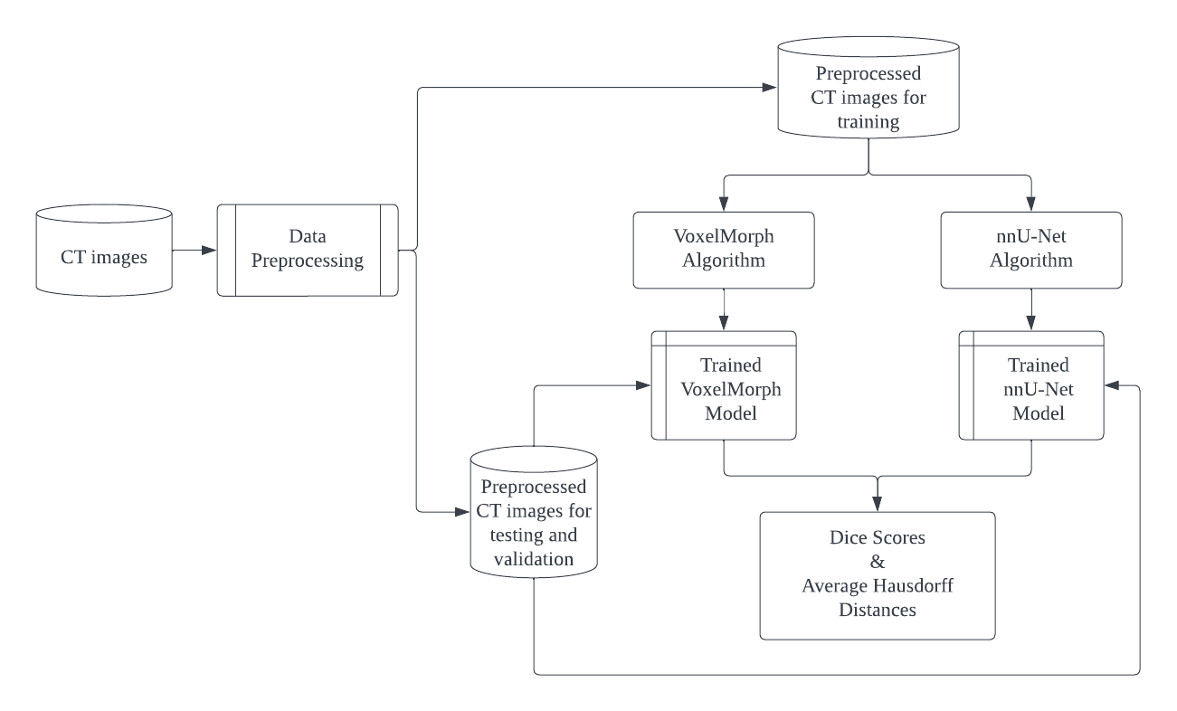
Workflow
1. Crop the region of interest (ROI) from 512*512*256 to 240*240*240 and convert testing, validation and training CT datasets from .nifti files to .npz
2. Train models with the processed training images
3. Test the two trained models with validation images
4. Review the result from the Dice Coefficient Scores and Average Hausdorff Distances.

Slide 8
Result
Segmentation and Registration of Brain Tumor based on nnU-Net and Voxelmorph
 | nnU-Net |  | VoxelMorph
Name | Dice Score | Average Hausdorff Distance | Dice Score | Average Hausdorff Distance
CVHN_308 | 0.73386351 | 3.102099068 | 0.550708322 | 3.422939684
CVHN_367 | 0.803976272 | 1.907423993 | 0.625511323 | 3.77215801
CVHN_412 | 0.163808638 | 16.75043043 | 0.557578369 | 3.69789234
CVHN_869 | 0.708315434 | 2.395088666 | 0.424232461 | 5.859322669
CVHN_838 | 0.450067758 | 8.710050878 | 0.277045361 | 13.18029103
CVHN_488 | 0.627526769 | 3.896385943 | 0.438617091 | 6.019322202
CVHN_609 | 0.240037951 | 3.869196222 | 0.082198863 | 10.02374945
CVHN_088 | 0.794220902 | 1.628269231 | 0.423731139 | 4.634777631
CVHN_067 | 0.713886717 | 2.063536097 | 0.608115355 | 3.287171587
CVHN_560 | 0.843824965 | 1.316909633 | 0.699757371 | 2.791373435
CVHN_519 | 0.565362565 | 7.192020796 | 0.36735845 | 9.496100228
CVHN_356 | 0.817110694 | 1.844885556 | 0.082198863 | 10.02374945
CVHN_192 | 0.780641673 | 1.744061265 | 0.398588453 | 5.141719313
CVHN_813 | 0.881820123 | 1.012853212 | 0.524958264 | 5.249528823
 | average = 0.65 |  | average = 0.43

Slide 9
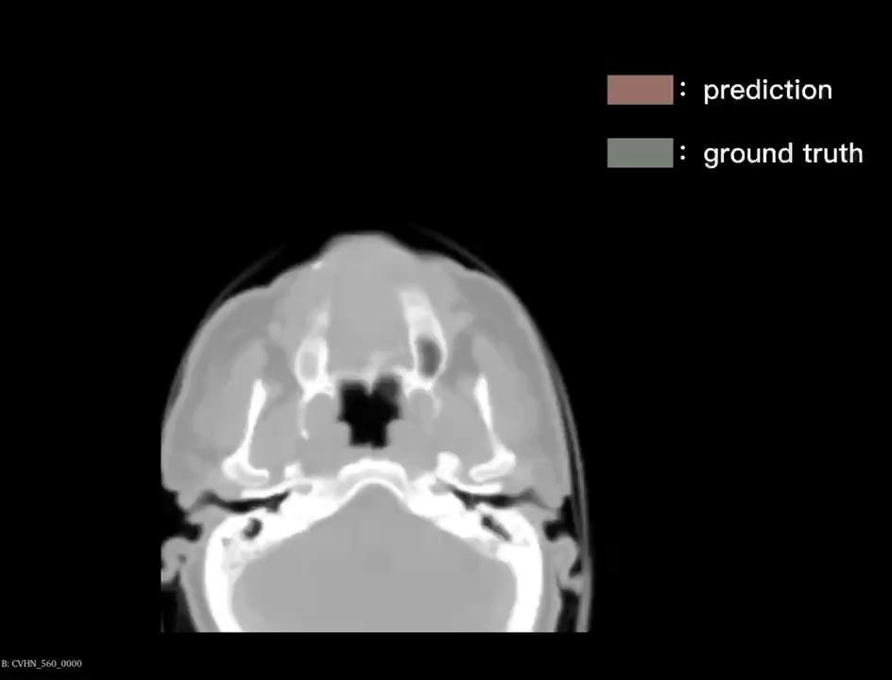
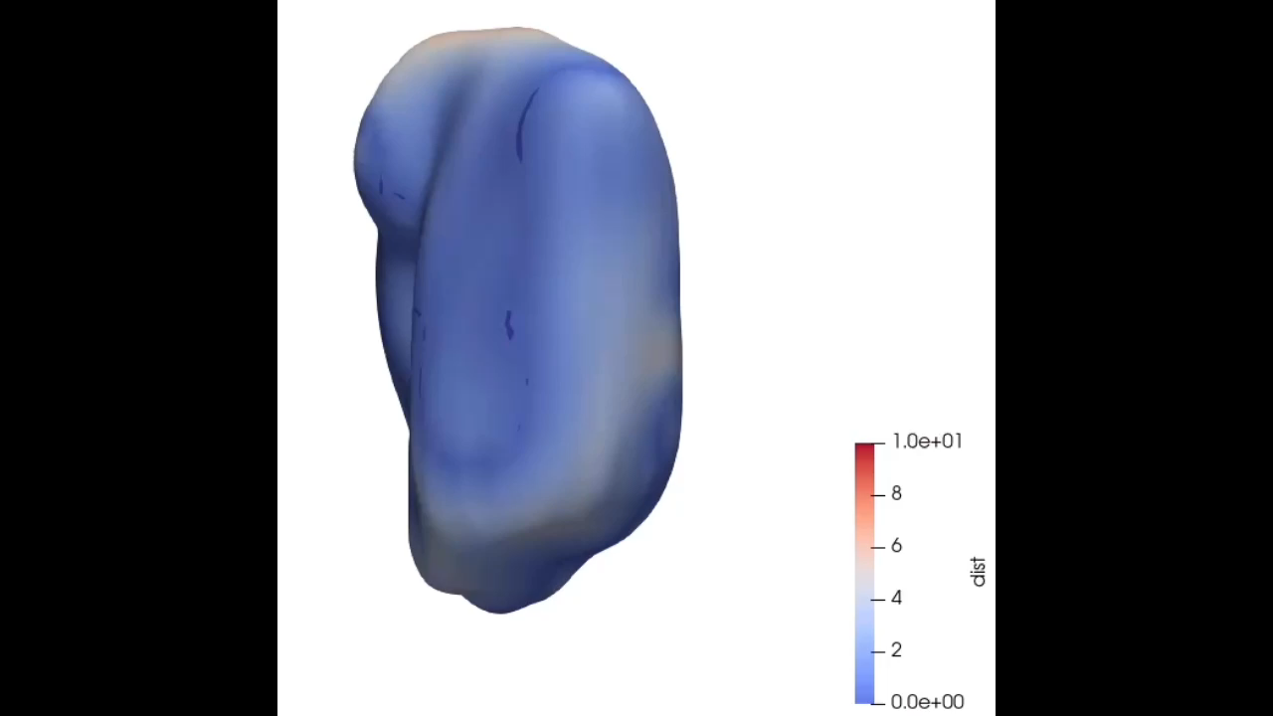
Result—nnU-Net (HN1560)
Segmentation and Registration of Brain Tumor based on nnU-Net and Voxelmorph
Dice Score = 0.84

Slide 10
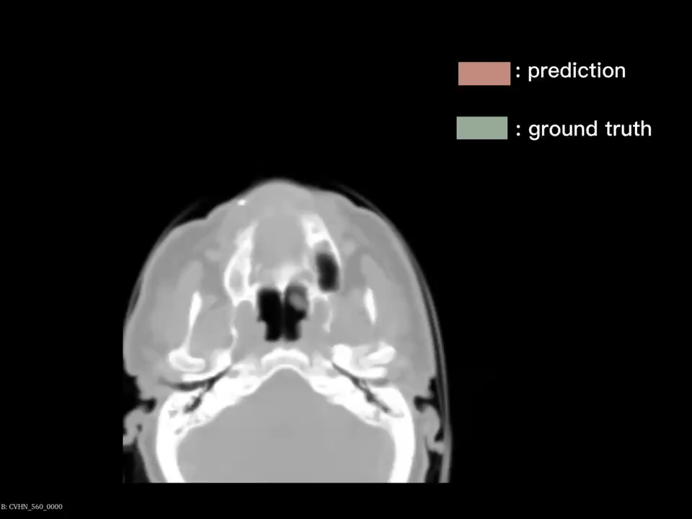
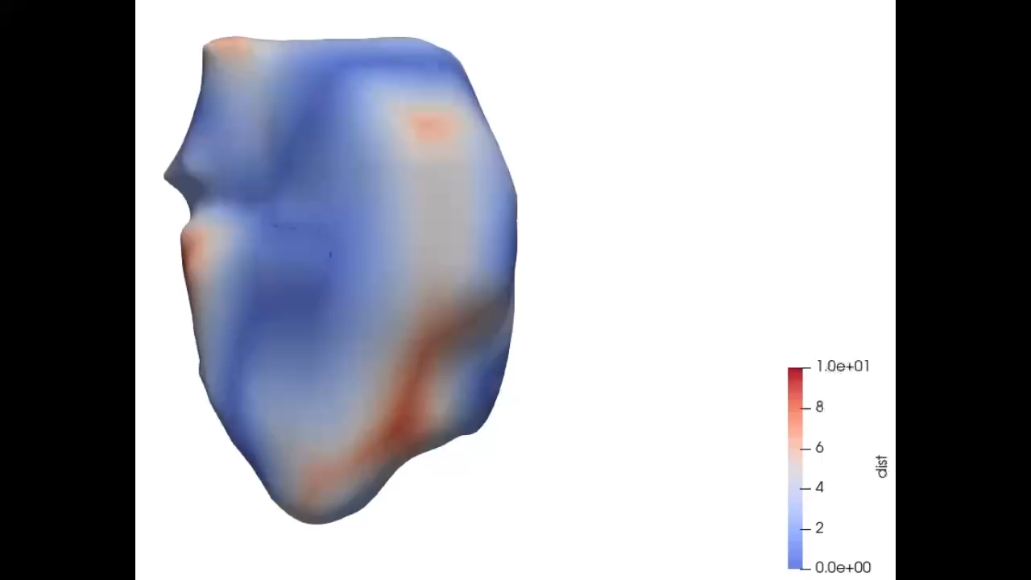
Result—Voxelmorph (HN1560)
Segmentation and Registration of Brain Tumor based on nnU-Net and Voxelmorph
Dice Score = 0.70

Slide 11
Future improvement
Segmentation and Registration of Brain Tumor based on nnU-Net and Voxelmorph
Collect more labeled data
Improve architecture
Add residual units
Modify encoder & decoder
Modify hyper-parameters
optimizer
learning rate
loss function
Dropout rate

Slide 12
Q&A

